Slide 1
Presented By: Akash Pratap Singh
Decision Tree Classification Using CART Algorithm.

Slide 2
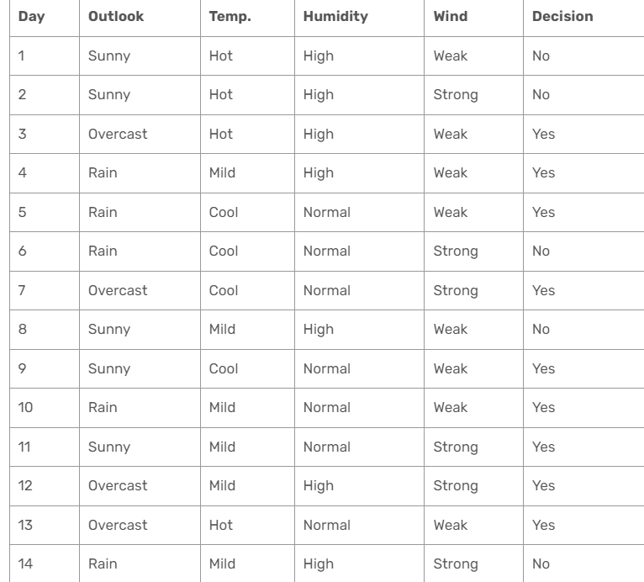
Decision Tree Classification Using CART Algorithm

Slide 3
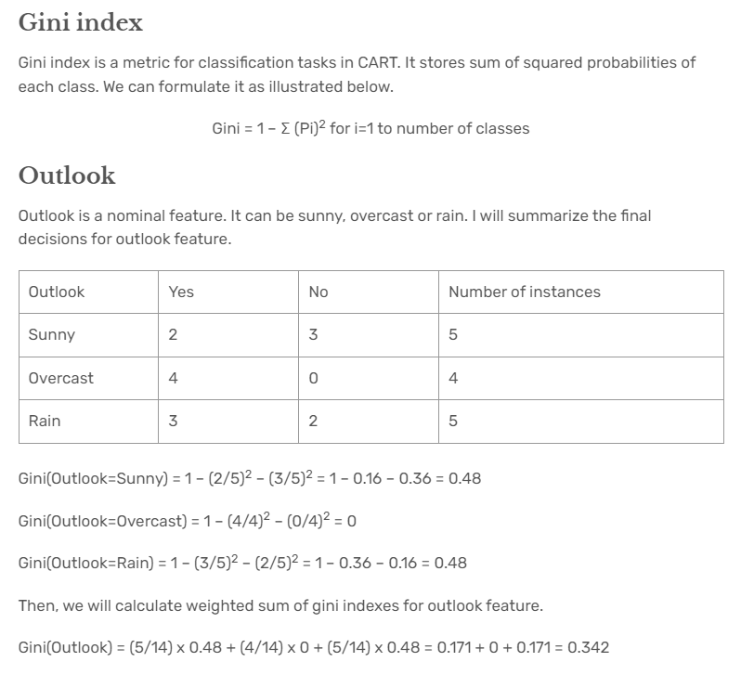
Decision Tree Classification Using CART Algorithm

Slide 4
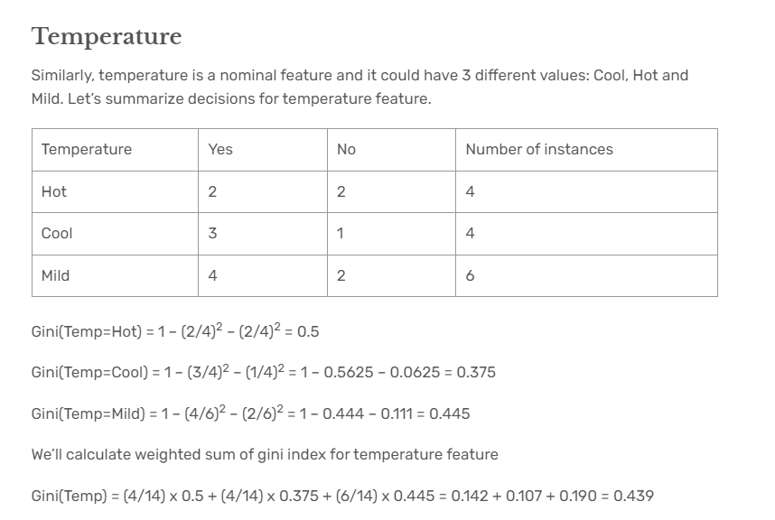
Decision Tree Classification Using CART Algorithm

Slide 5
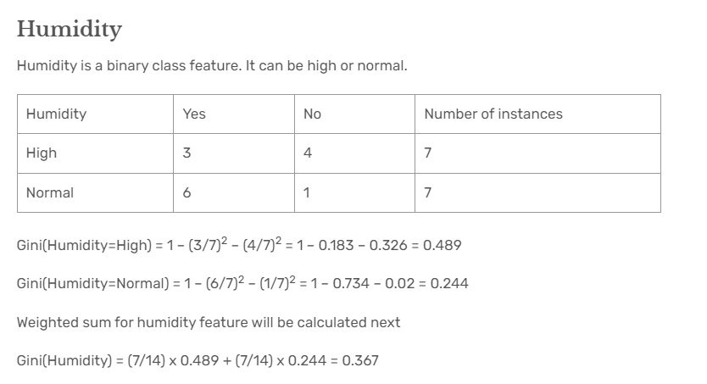
Decision Tree Classification Using CART Algorithm

Slide 6
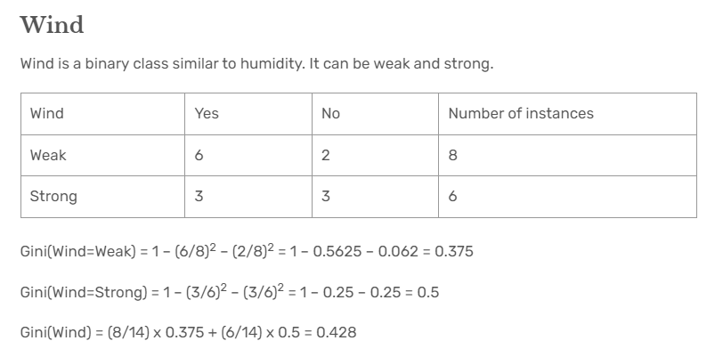
Decision Tree Classification Using CART Algorithm

Slide 7
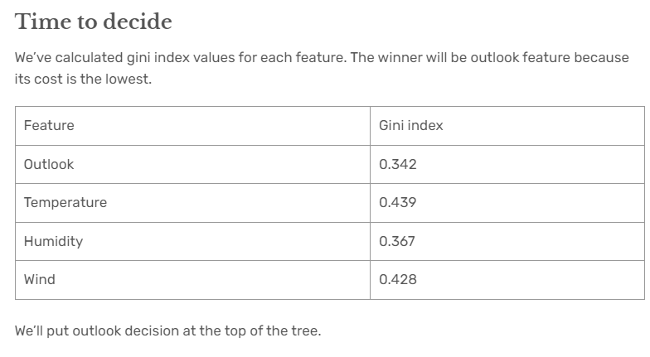
Decision Tree Classification Using CART Algorithm

Slide 8
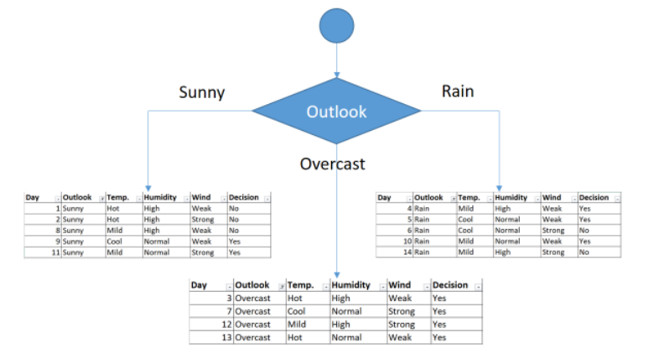
Decision Tree Classification Using CART Algorithm

Slide 9
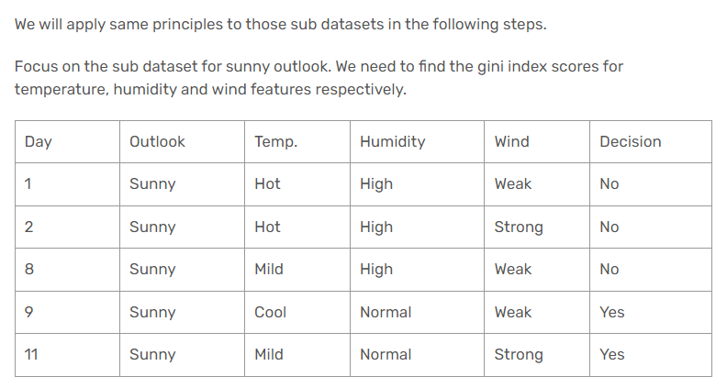
Decision Tree Classification Using CART Algorithm

Slide 10
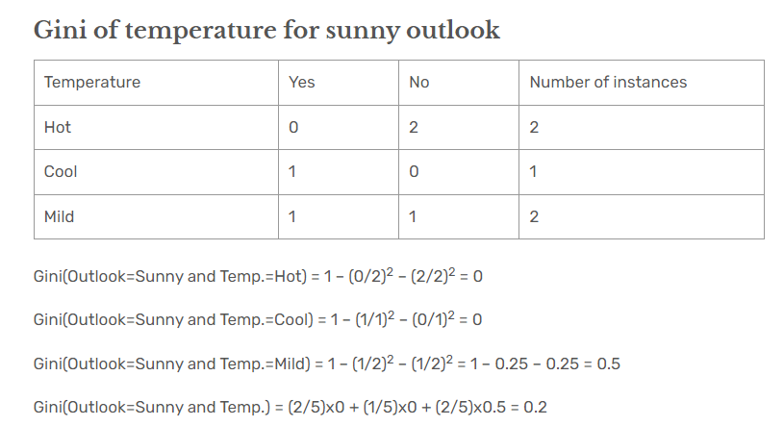
Decision Tree Classification Using CART Algorithm

Slide 11
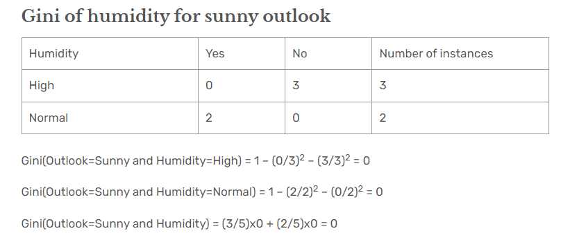
Decision Tree Classification Using CART Algorithm

Slide 12
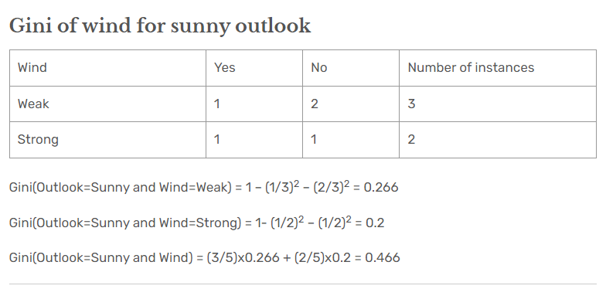
Decision Tree Classification Using CART Algorithm

Slide 13
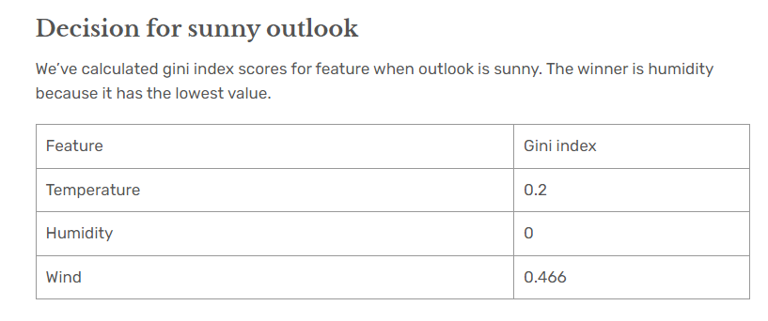
Decision Tree Classification Using CART Algorithm

Slide 14
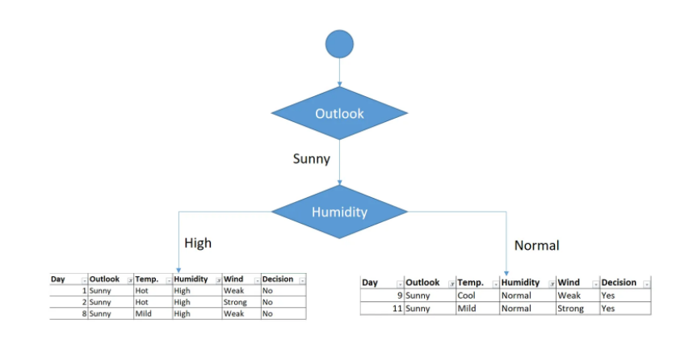
Decision Tree Classification Using CART Algorithm

Slide 15
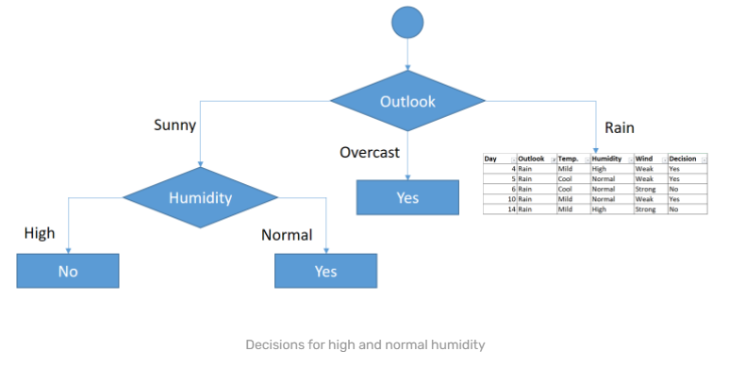
Decision Tree Classification Using CART Algorithm

Slide 16
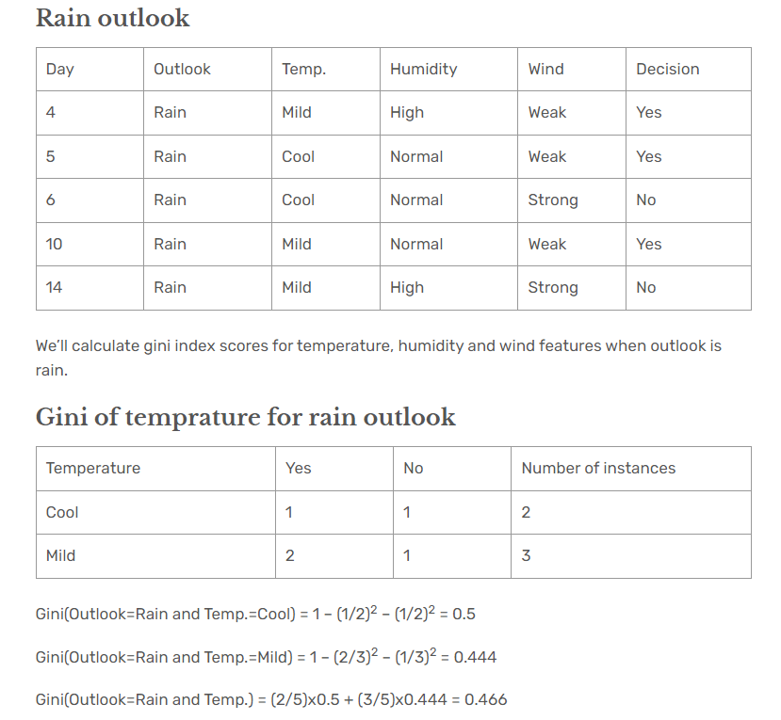
Decision Tree Classification Using CART Algorithm

Slide 17
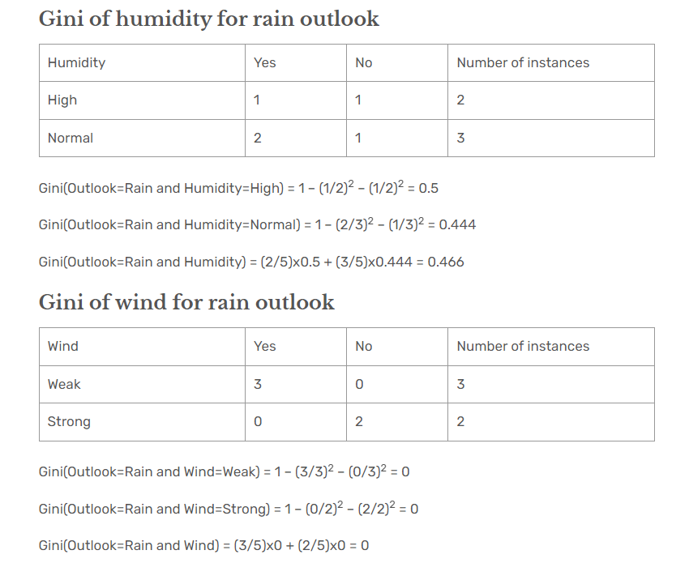
Decision Tree Classification Using CART Algorithm

Slide 18
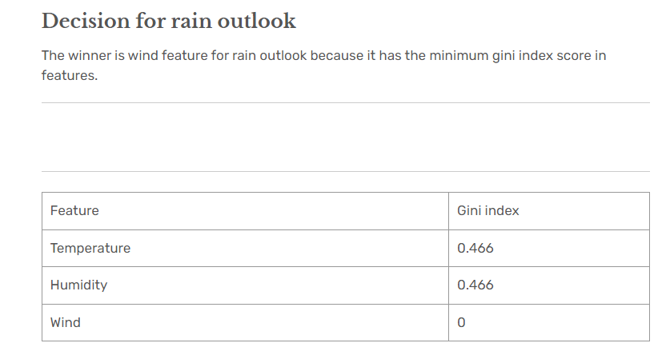
Decision Tree Classification Using CART Algorithm

Slide 19
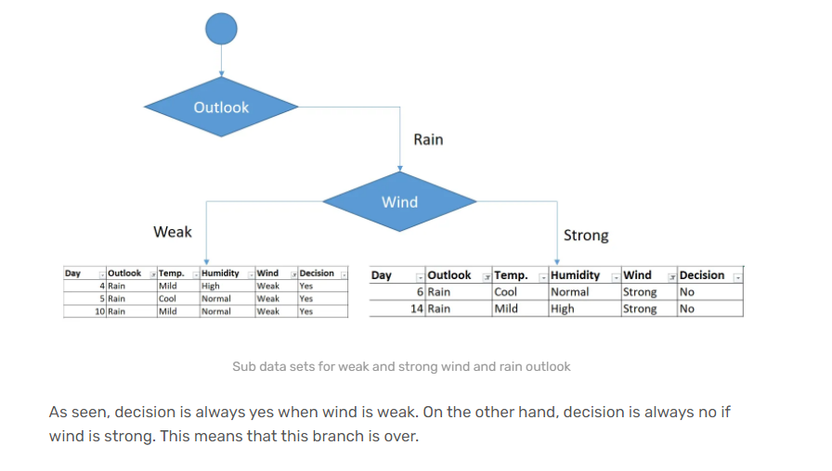
Decision Tree Classification Using CART Algorithm

Slide 20
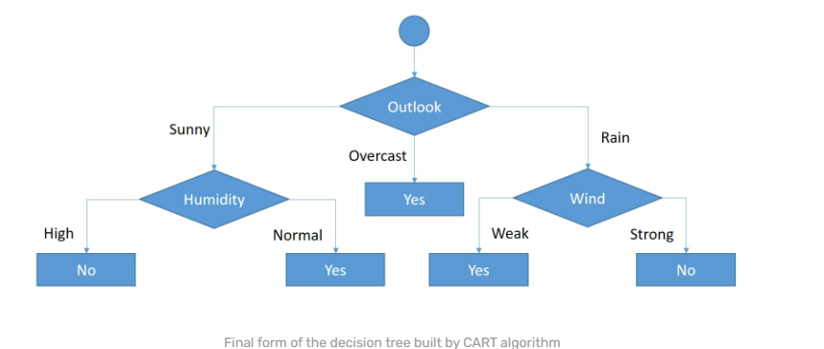
Decision Tree Classification Using CART Algorithm

Slide 21
Decision Tree Classification Using CART Algorithm
2nd Method

Slide 22
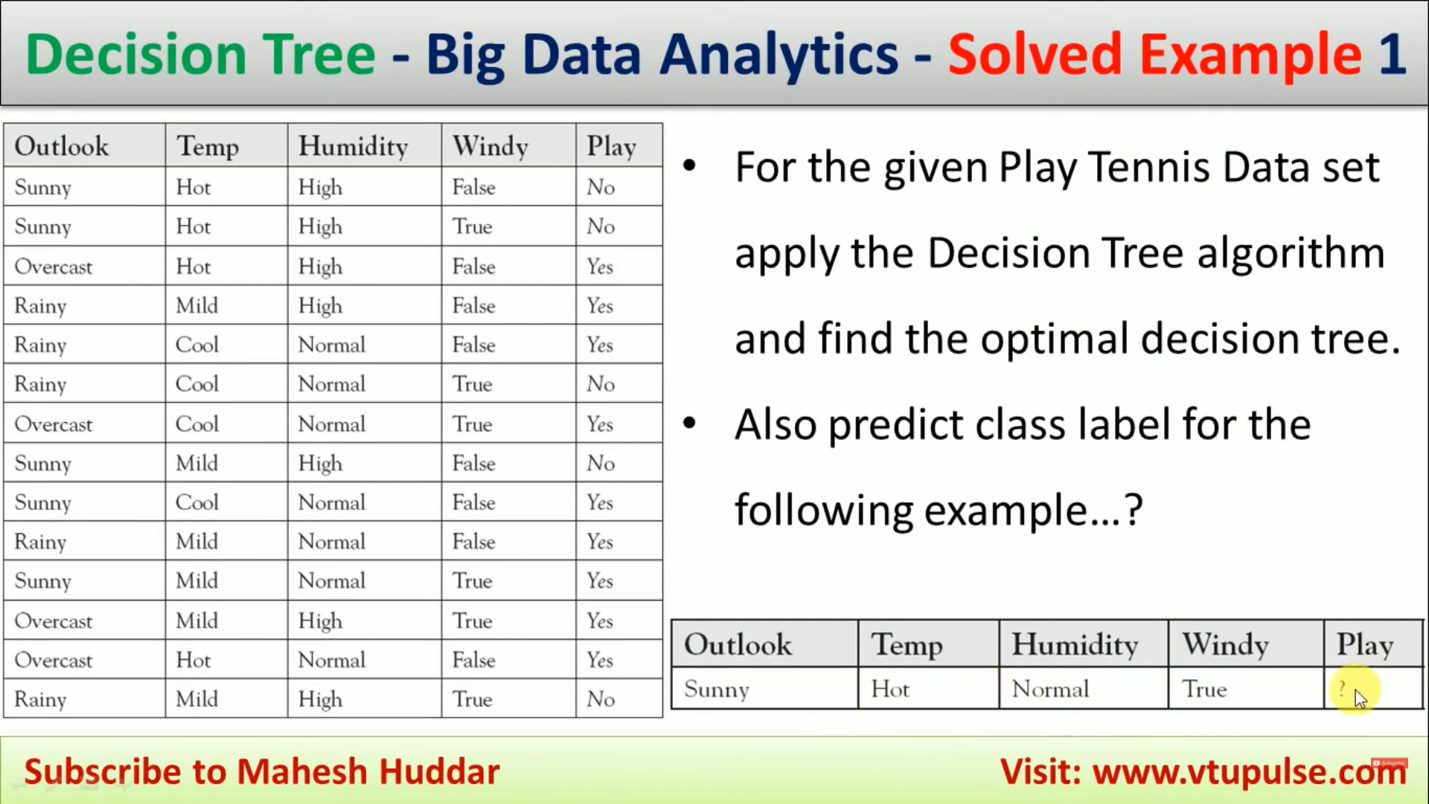
Decision Tree Classification Using CART Algorithm

Slide 23
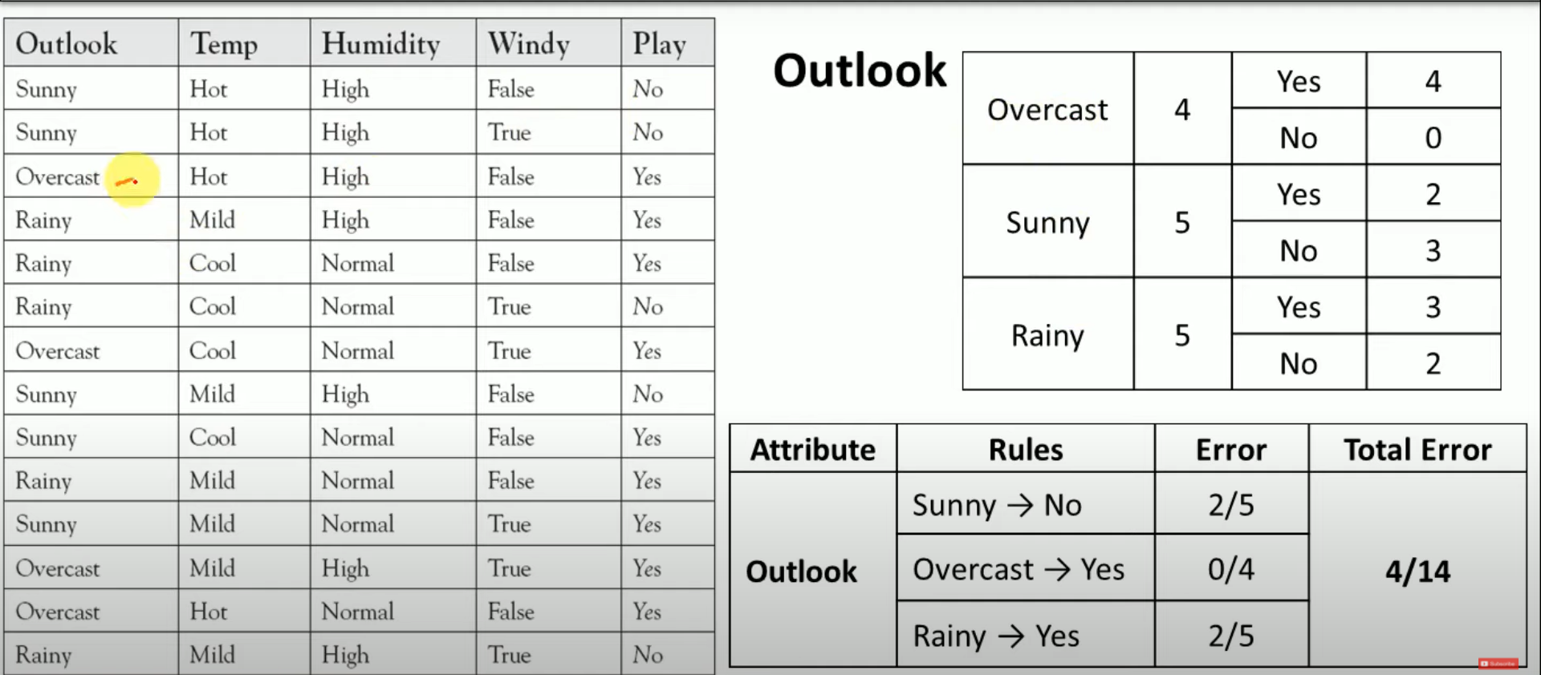
Decision Tree Classification Using CART Algorithm

Slide 24
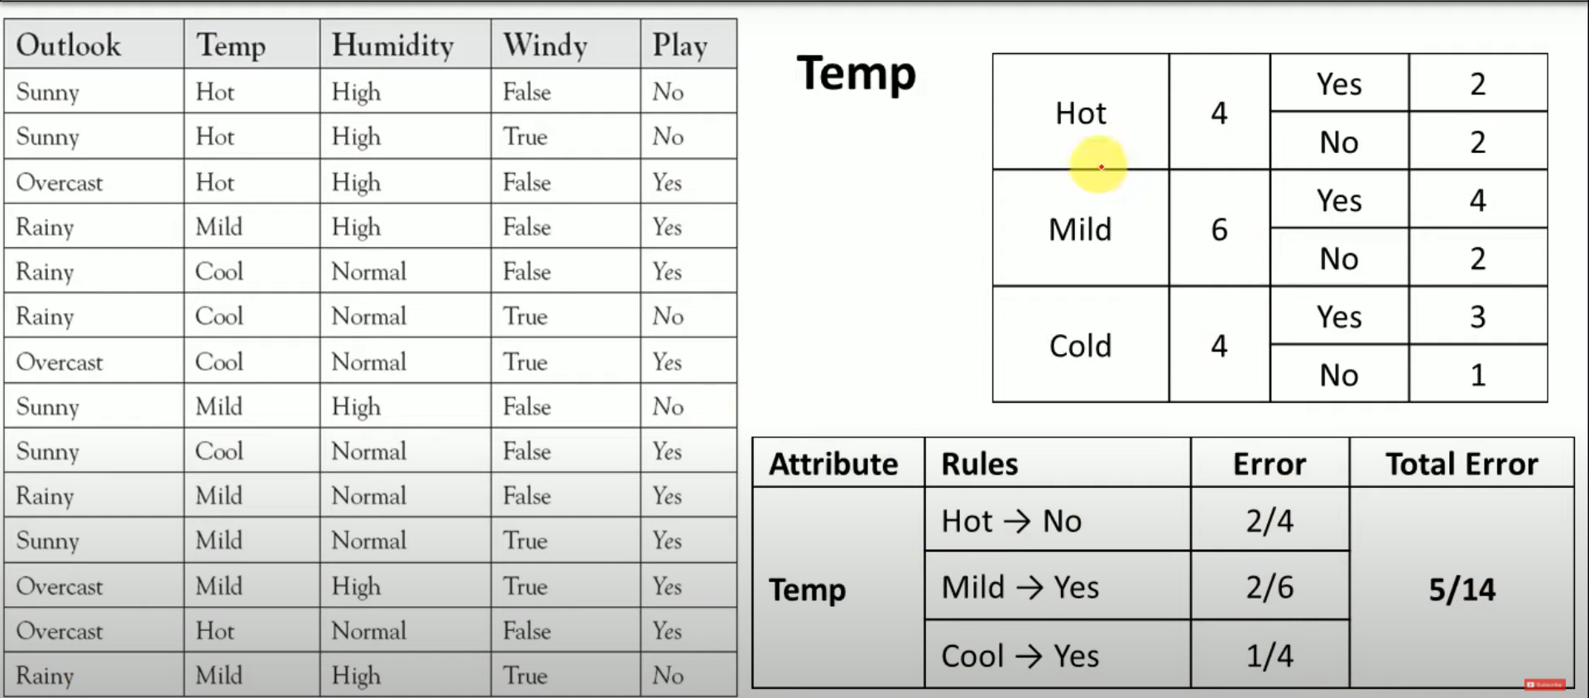
Decision Tree Classification Using CART Algorithm

Slide 25
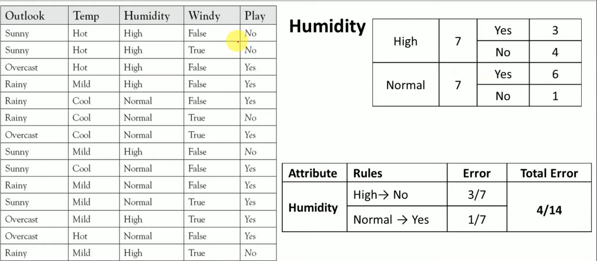
Decision Tree Classification Using CART Algorithm

Slide 26
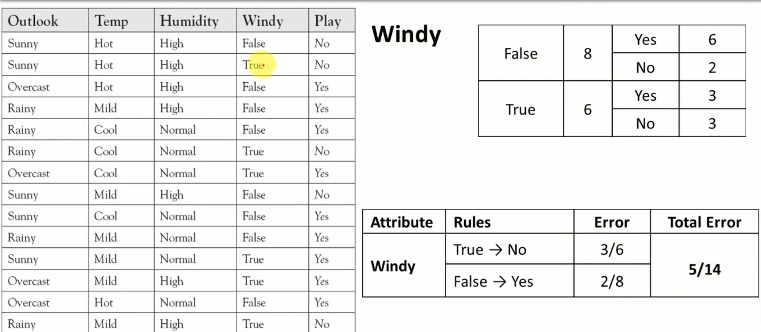
Decision Tree Classification Using CART Algorithm

Slide 27
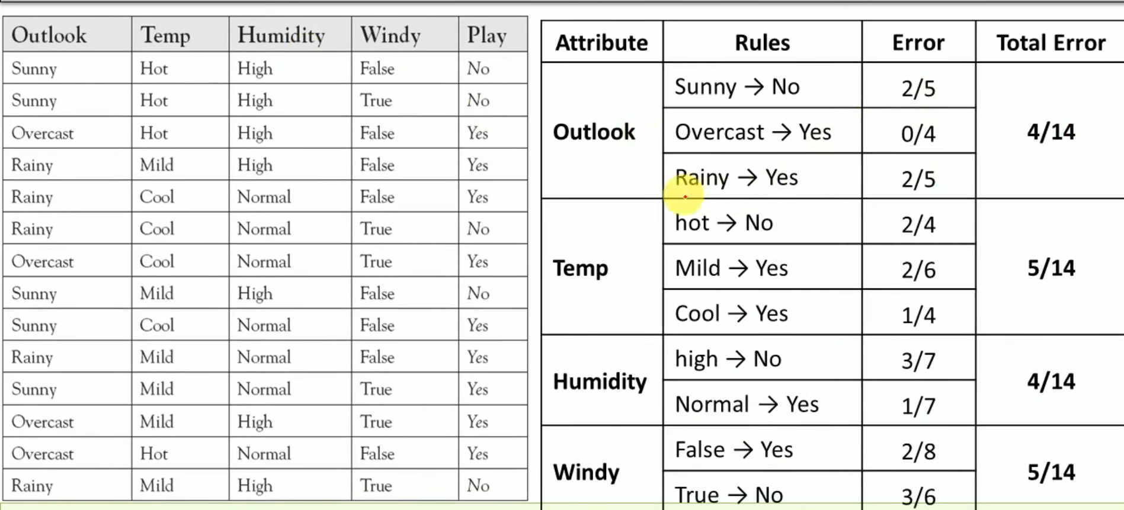
Decision Tree Classification Using CART Algorithm

Slide 28
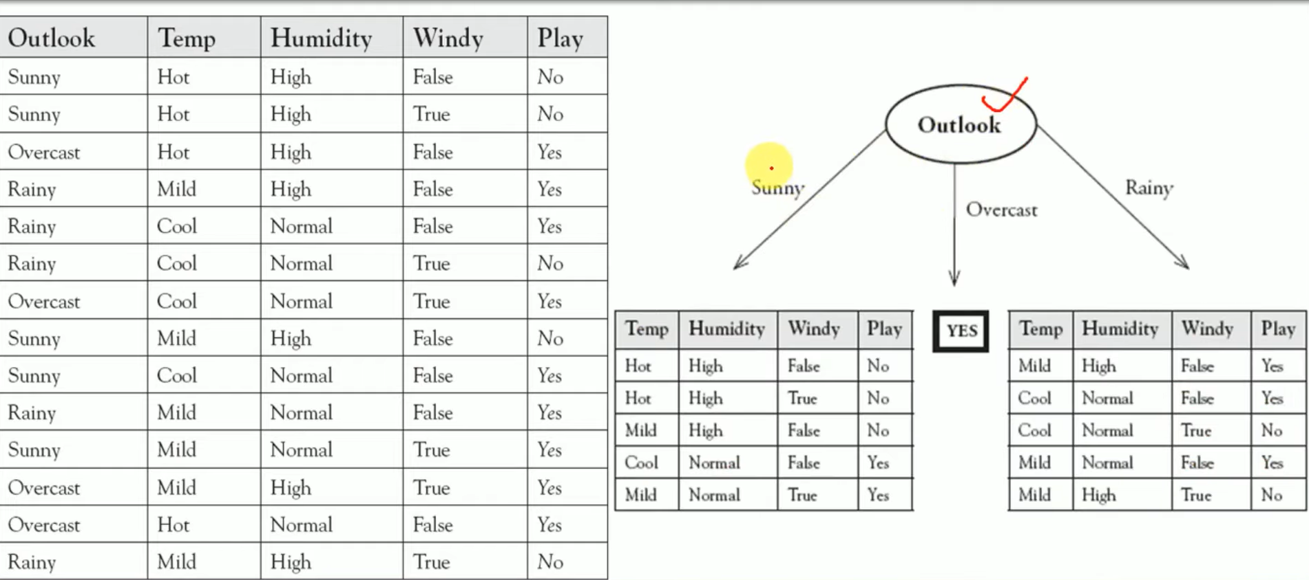
Decision Tree Classification Using CART Algorithm

Slide 29
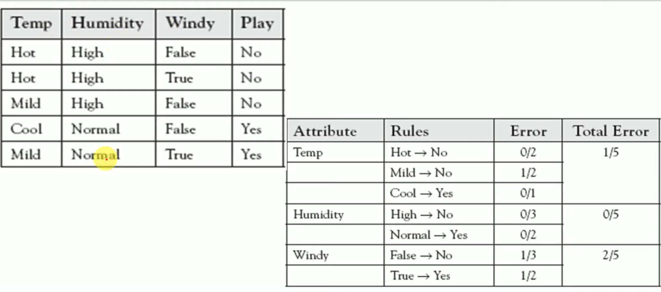
Decision Tree Classification Using CART Algorithm

Slide 30
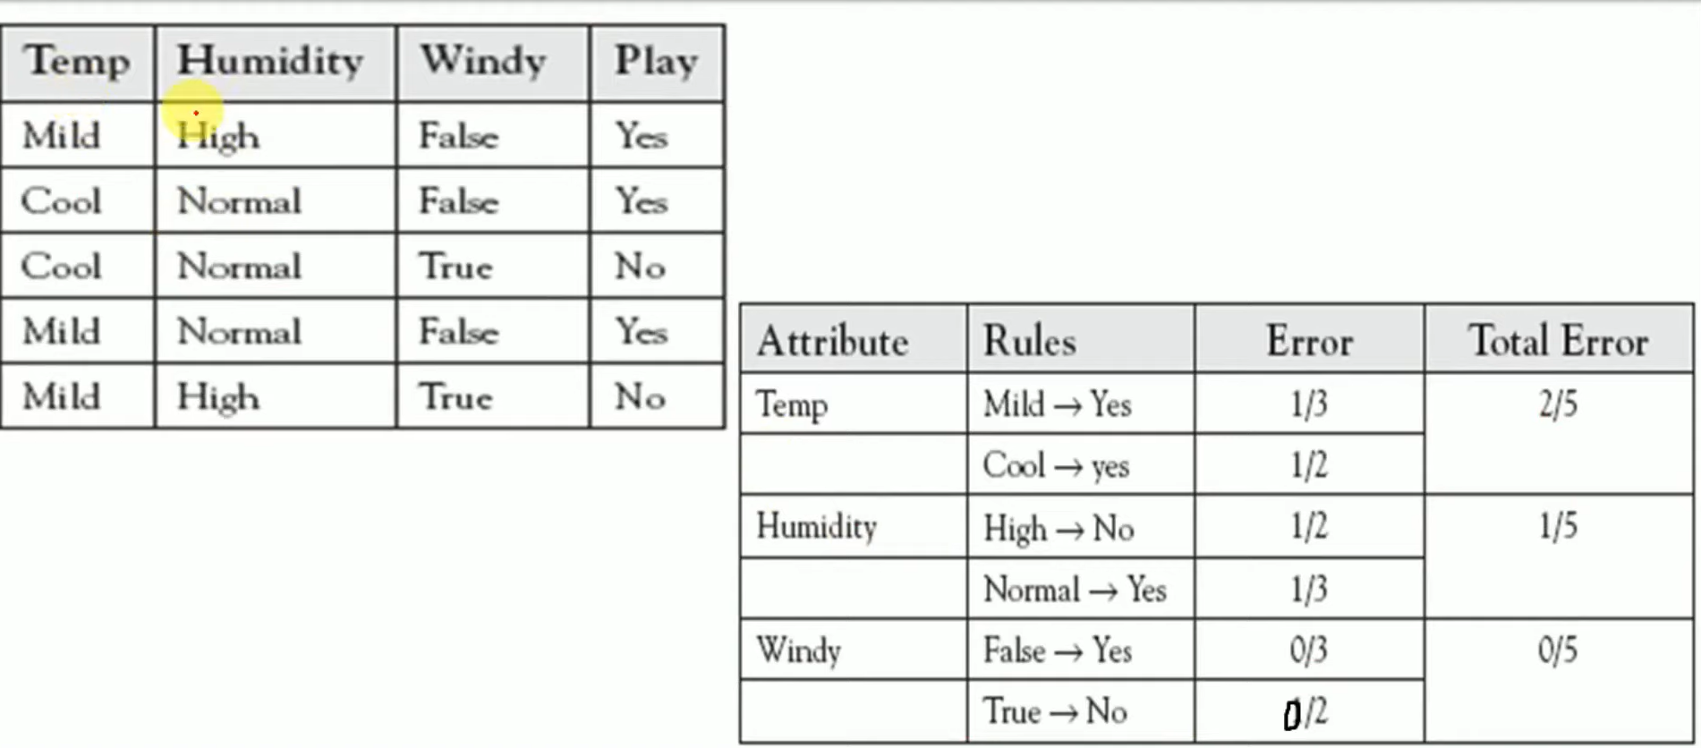

Decision Tree Classification Using CART Algorithm

Slide 31
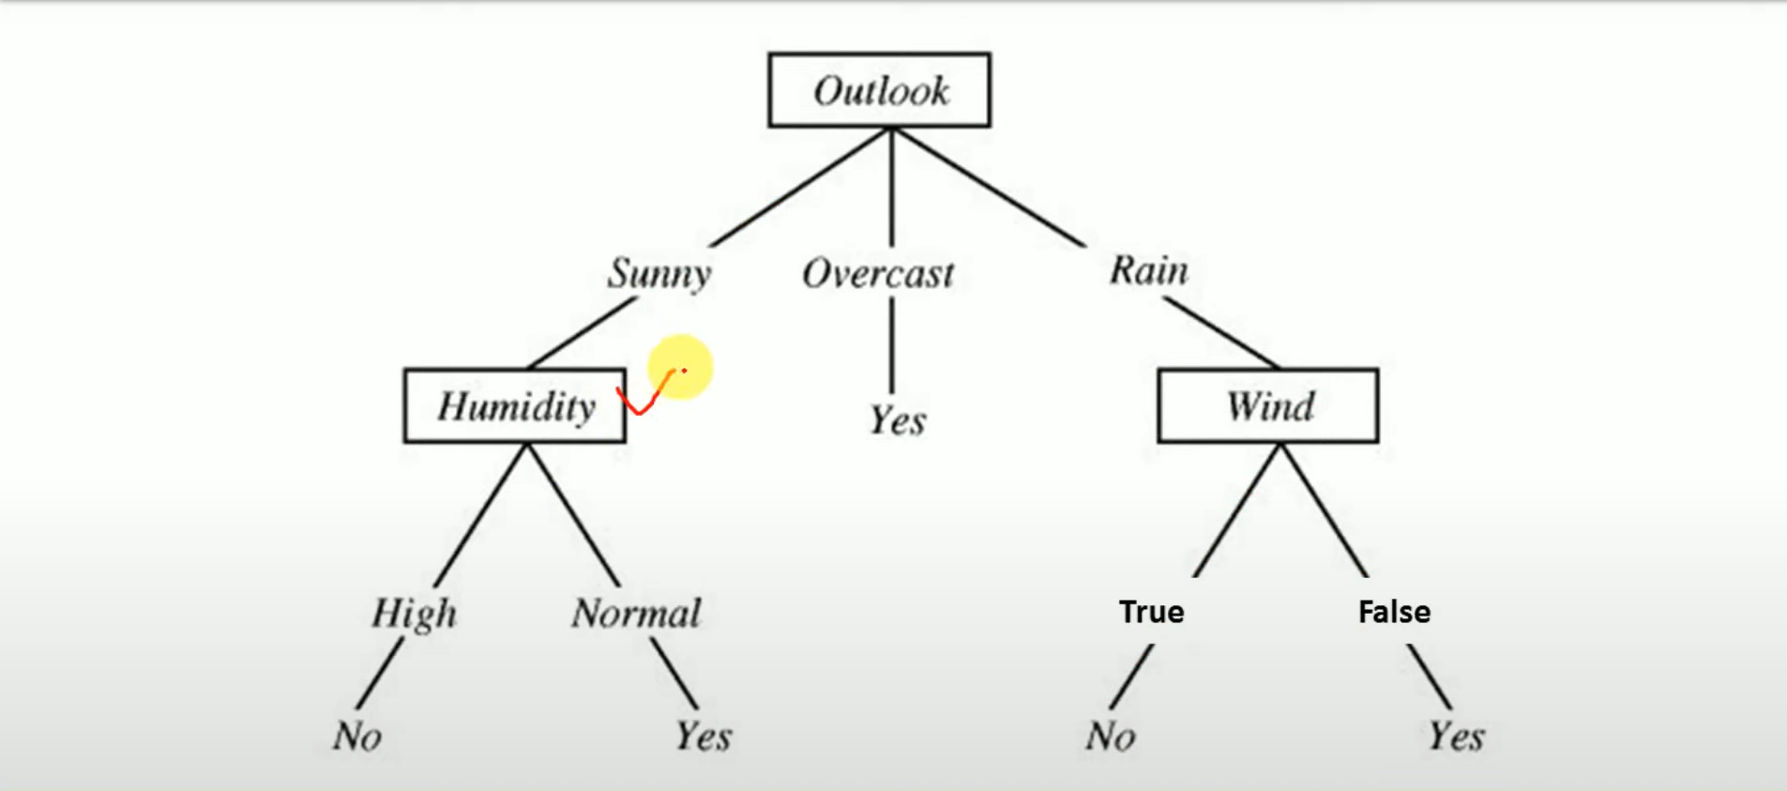
Decision Tree Classification Using CART Algorithm

